Slide 1
Simulating Cryptographic Primitives in Model Based Systems Engineering Projects
Maria DiValentin
Jeremy Daily, Ph.D.

Slide 2

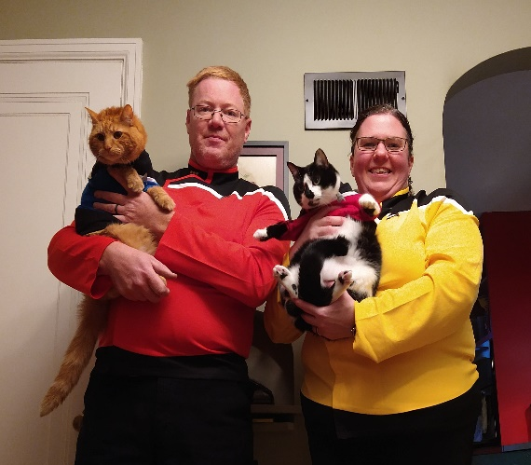
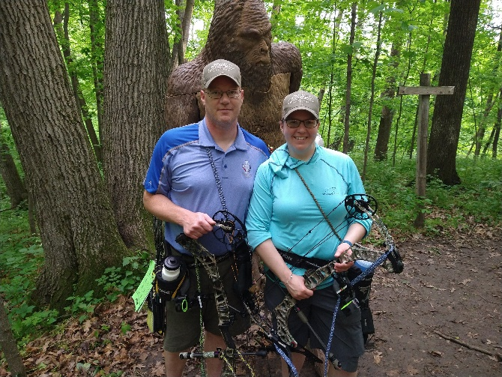




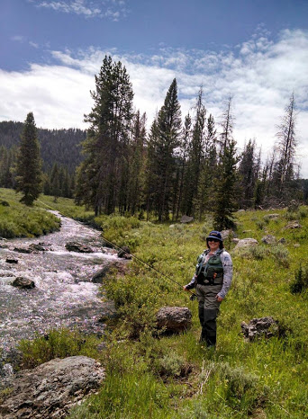

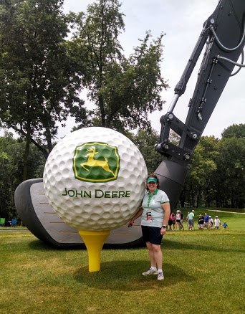

About the Author
Maria DiValentin
AS Pre-Engineering
BS Mechanical Engineering
ME Engine Systems
Masters Certificate Systems Engineering (Deere Program)
Pursuing PhD Systems Engineering
Field Service Representative (DTAC) - 2007-2008 (contract 2006-2007)
Customer Support Product Development Engineer 2008 – 2011
Continuous Improvement Engineer – HPCR Fuel System 2001 – 2016
Development Engineer – Low Pressure Fuel Systems (LPFS) 2016 – 2018
Sr Development Engineer – Low Pressure Fuel Systems (LPFS) 2018 – 2021
Sr Engine Application Engineer OEM/Marine - 2021 – 2024
Sr Application Engineer – 2024 - Present
Hobbies: Cycling, Kayaking, Archery,
Fly Fishing, Golf, Hockey

Slide 3
Presentation Journey
Motivation​
Mission
​Threat Model
Research Contributions
Provisioning Workflow​
Cryptographic Simulation​
Key Takeaways and Future Work​

Slide 4
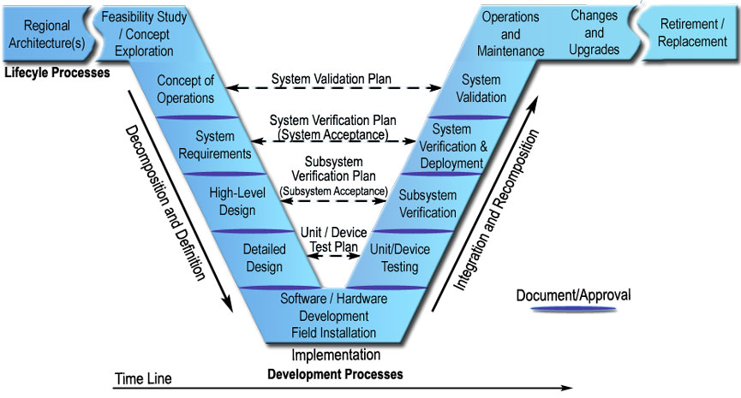
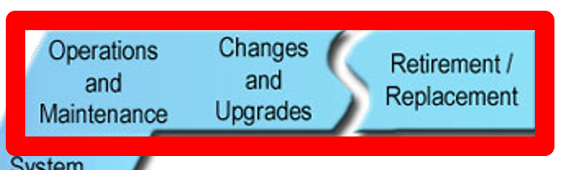
Why This Matters
Vehicle cybersecurity threats are increasing​
Modular Open Systems Approach (MOSA) and right-to-repair increase system accessibility​
Regulations on emission systems such as European Cyber Resilience Act (CRA) understood earlier in development​
Target: heavy-duty diesel engine smart sensors and actuators ​
U.S Department of Transpiration, Federal Highway Administration

Slide 5
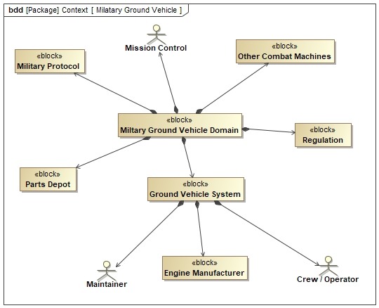
Military Vehicle Ecosystem
Stakeholders: engine manufacturer, maintainer, operator, parts depot​
Regulations and military protocol requirements​
Interface with other combat machines
Cybersecurity requirements must be traceable​
Highly aligned to agriculture and construction industry with exception of emissions focus

Slide 6
Mission Statement
To demonstrate protection of message exchange unidirectional between CAN smart sensor and ECU
By ensuring integrity and freshness of message during sensor replacement/maintenance
Using Model Based Systems Engineering (MBSE) to simulate cybersecurity elements

Slide 7
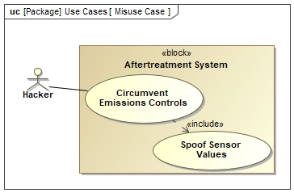
Challenges
Controller Area Network (CAN) enables robust communication but lacks built-in security​
Attackers can spoof emissions sensors​
Need message authenticity, integrity, and freshness​
Image show emission system but can be applied to any system with smart sensors or actuators

Slide 8
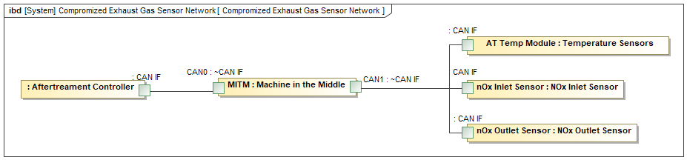
Threat Model
Adversary has physical possession of the machine
Machine-in-the-Middle inserted on CAN network​
Intercepts and modifies NOx / temperature sensor data​
Can alter engine control behavior​

Slide 9
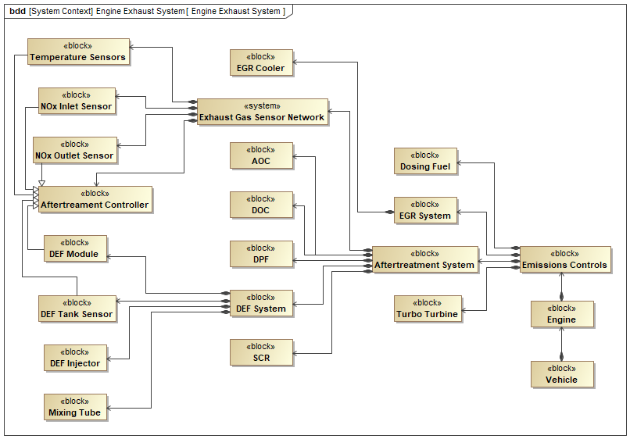
Why Smart Sensors/Actuators Are an Attractive Target​
Smart sensors and actuators drive closed-loop control​
Spoofed readings can manipulate system behavior​
Multiple entry points, increase attack surface
Message integrity becomes critical​
Notes:
Relationships (generalization vs composition…)

Slide 10
Research Contribution
MBSE simulation executes real cryptographic primitives​
External Python scripts integrated through opaque actions​
Model reflects actual security behavior​ during the maintenance period on smart sensors
MBSE Approach
Tool: CATIA Magic Systems of Systems Architect​ (MSOSA)
Language: SysML v1​
Method: MagicGrid inspired modeling​
Executable simulations using Python​

Slide 11
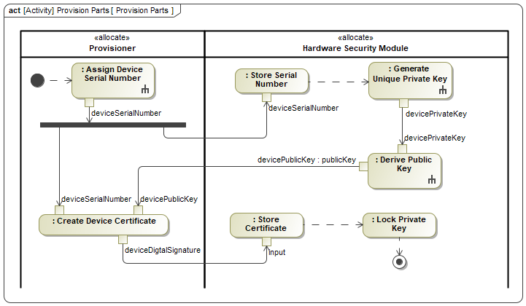
Provision Parts Workflow
Assign serial number​
Generate Elliptical Curve Cryptography private key​
Derive public key​
Create certificate​
Store device data​
Lock private key​
Note: Portion of full crypto system

Slide 12
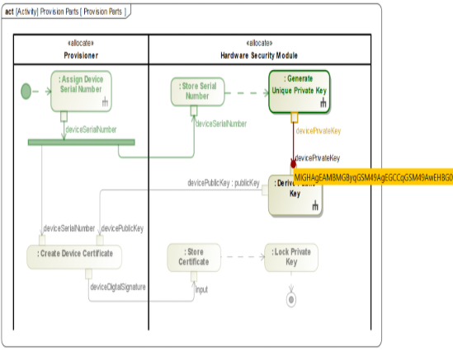
Why Executable Crypto Matters
Executable Crypto in MBSE Model
Eliminates placeholder values​
Detects modeling mistakes​
Improves design fidelity​
Improves stakeholder confidence
Order of operations enforced by simulation​
Benefits
Earlier cybersecurity validation​
Improved digital engineering rigor​
Requirements traceability​
Reusable security patterns​

Slide 13
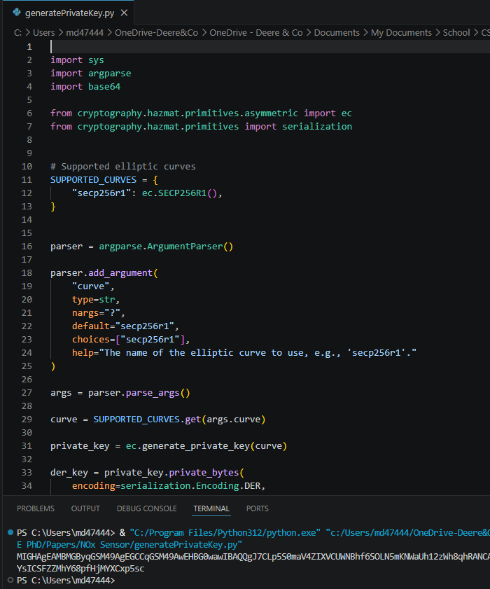
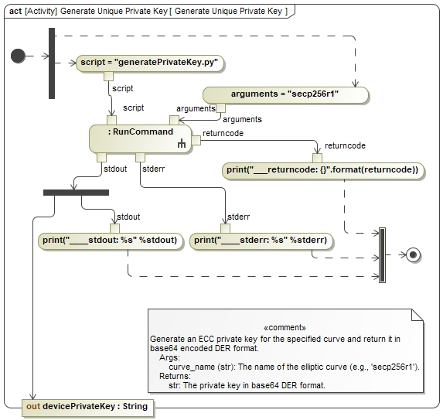
Example Python Script

Slide 14
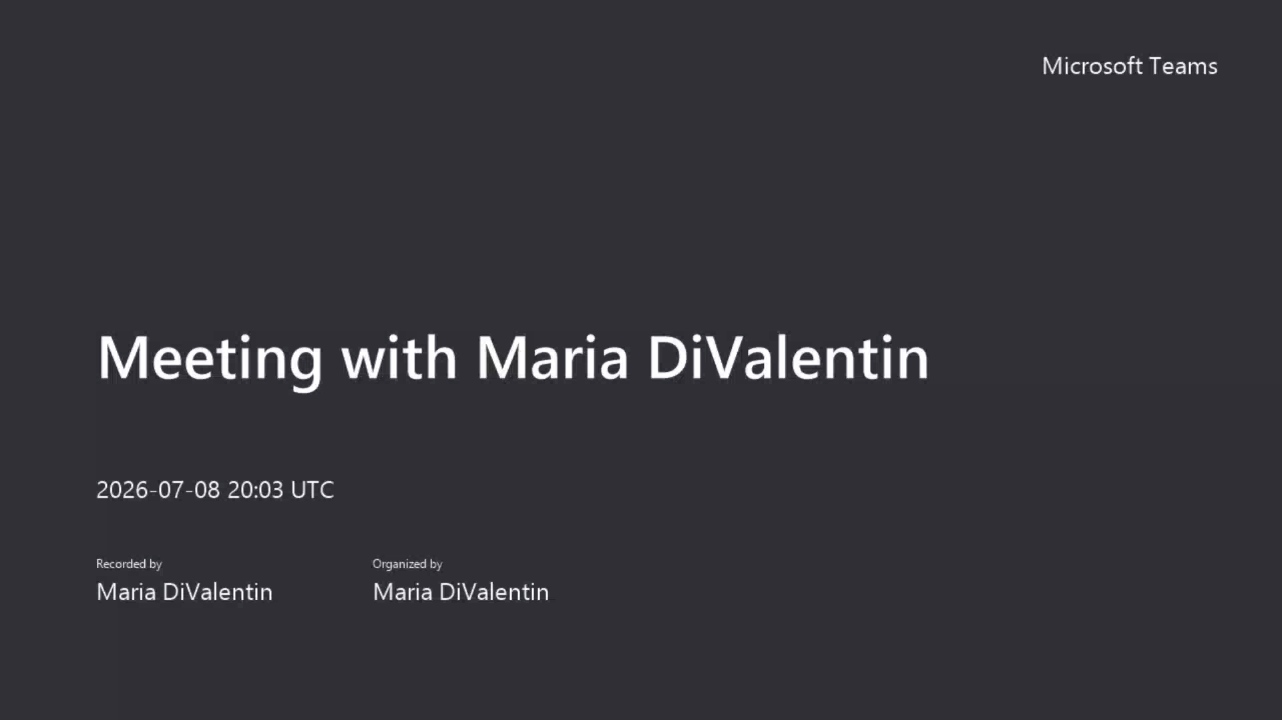
Video of Model

Slide 15
Key Takeaways​
MBSE can model and execute real cybersecurity workflows​
Approach supports secure vehicle architectures​
Modeling primitives improves design fidelity and earlier verfication
The systems engineering can better communicate with cybersecurity team

Slide 16
Future Work​
Additional secure maintenance concepts​
Integrate physical Hardware Security Module (HSM) signal into MBSE model
Explore using SysML v2​

